Slide 1















Literacy Quest: The Goal-Setting Challenge

Slide 2


Welcome to Literacy Quest!
Set your goal,
complete challenges,
and earn badges on your journey to becoming a confident reader and writer!

Slide 3

MY GOALS:
Set Your SMART Literacy Goal
Instructions: Think of something you want to improve in reading or writing. Use the SMART goal guide to write it.
🎯 Goal Setter
BADGE EARNED:
POINTS EARNED: 10 PTS

Slide 4


Challenge 1: Reading Boost
Task: Read the short article on the next slide. Highlight the main idea in one color and one supporting detail in another color.
Reading Rockstar
BADGE EARNED:
POINTS EARNED: 10 PTS

Slide 5


"The cheetah is the fastest land animal. It can run up to 70 miles per hour. It uses its speed to chase and catch prey. Cheetahs also have excellent eyesight, which helps them spot prey from far away. Their slender bodies and long legs make them built for speed. Though fast, cheetahs can only sprint for short distances before getting tired."

Slide 6


MY FAVORITE BOOK
Challenge 2: Writing Focus
Task: Write 3–5 sentences about your favorite book or show using at least two descriptive words.
Creative Writer
BADGE EARNED:
POINTS EARNED: 10 PTS

Slide 7

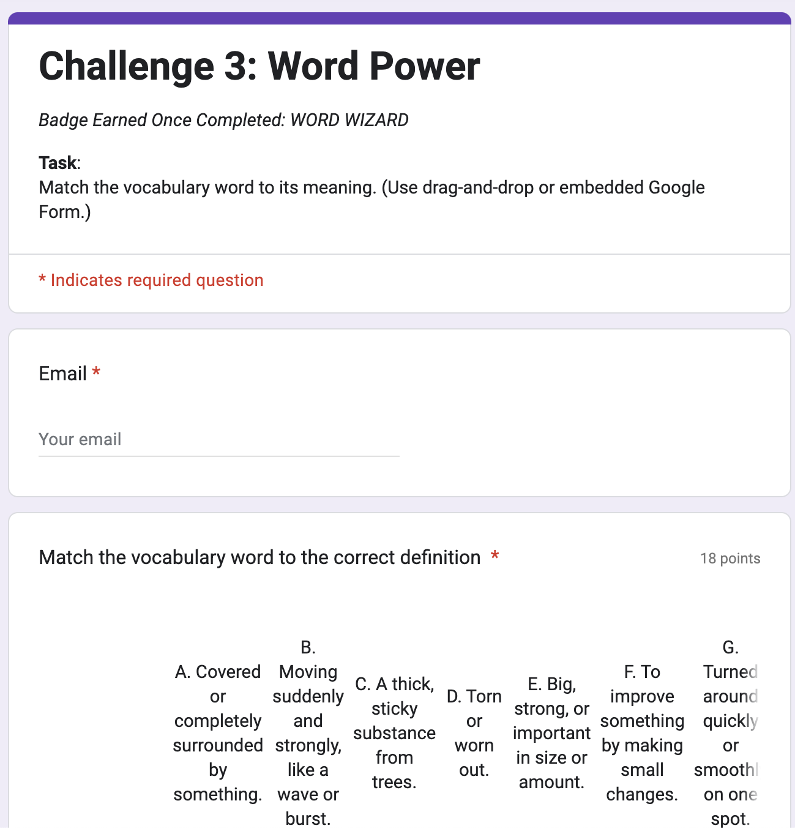
Challenge 3: Word Power
Google Form Link for Challenge 3: Word Power
Task: Match the vocabulary word to its meaning. Click on the link to go to the Google Form
Word Wizard
BADGE EARNED:
POINTS EARNED: 10 PTS

Slide 8

MY REFLECTION
REFLECTION
Prompt: Did you meet your goal? What did you learn about yourself as a reader /writer?
Reflective Thinker
BADGE EARNED:
POINTS EARNED: 20 PTS

Slide 9
Final Score + Celebration information
Total up your points and badges on the next slide.
Reminder: 10 pts per task + 20 for reflection = 60 pts total

Slide 10
BADGES POINTS
EARNED
DIRECTIONS: CLICK AND DRAG THE BADGES YOU EARNED TO THE BOX, THEN WRITE THE POINT VALUE NEXT TO IT.
1O PT.
1O PT.
1O PT.
1O PT.
2O PT.

Slide 11
CELEBRATION
🎉 You completed the quest!

Slide 12
References
Ereading Worksheets. (n.d.). Main idea worksheet 01-01 [Worksheet]. https://www.ereadingworksheets.com/reading-worksheets/main-idea-worksheet-01/preview/main-idea-worksheet-01-01.jpg
Nixon, T. (2024). TECH5233 Learning Design Activities and Assessment: Module 2 [Video Presentation]. Canvas. https://ace.instructure.com/courses/2089550/modules/items/42701452

